Slide 1


Palaeodata wrangling with the Tidyverse
Steve Juggins

Slide 2
Palaeodata Workflow
1
3
5
Set up working environ-ment
Clean, transform and tidy data
Modelling / statistical analysis
Retrieve data
Explore, visualise data
Publish, reproduce-able code
2
4
6
Not sexy, not clever, not always straightforward, and can be very time consuming.
Having a good set of tools in R can:
Increase efficiency
Reduce errors
Self-documenting & reproducible
Based on Fig 3, Slater et al. 2019. Using R in hydrology: a review of recent developments and future directions. Hydrology and Earth System Sciences 23:2939-2963.

Slide 3
Guiding principles
Everything is possible in Base R but solutions may be ad-hoc and need a mix functions & packages with different syntax: the Wild West that is Base R!
Tidyverse offers a consistent approach to data wrangling, fast, concise & logical syntax, and very flexible.
Some things may be faster in Base R but speed is rarely a limiting factor.
Focus on code that is simple, readable and easy to understand (promote learning, easier debugging, and reproducibility).
Today - don't get bogged down in the details of individual functions and operations. Focus on the big picture - the details will come with practice.

Slide 4



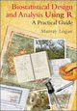
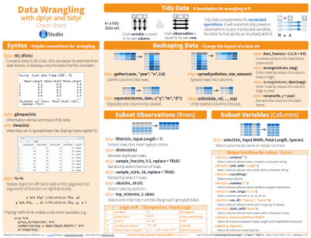

Resources
Whickham & Grolemund, R for Data Science, free online https://r4ds.had.co.nz/
Locke, R Fundamentals 2: Data Manipulation (£11)
https://itsalocke.com/company/books/
Bruno Rodrigues, Modern R with the tidyverse
free online https://b-rodrigues.github.io/modern_R/ or buy pdf for < £10
Murray Logan’s website, excellent tutorials & book
https://www.flutterbys.com.au/stats/
Rstudio cheatsheets
https://www.rstudio.com/resources/cheatsheets/
+ 1001 other websites…

Slide 5
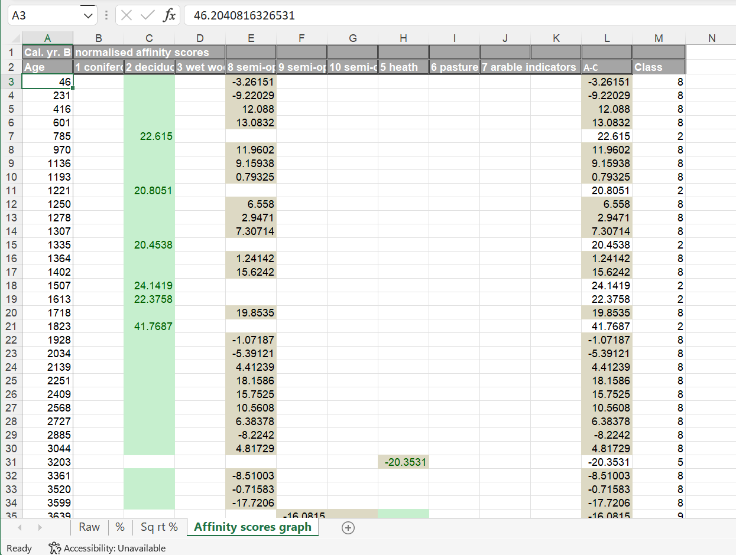
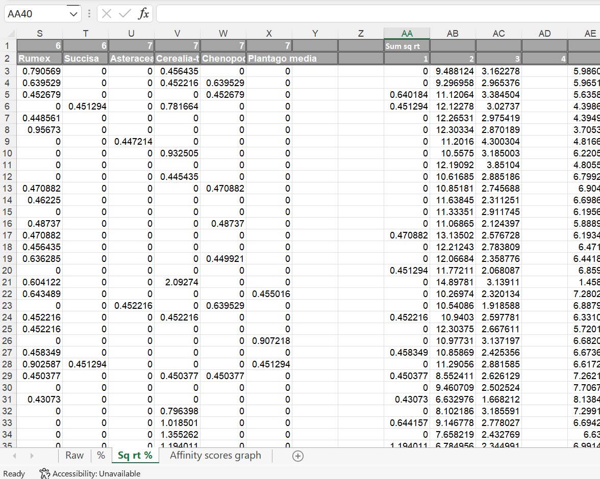
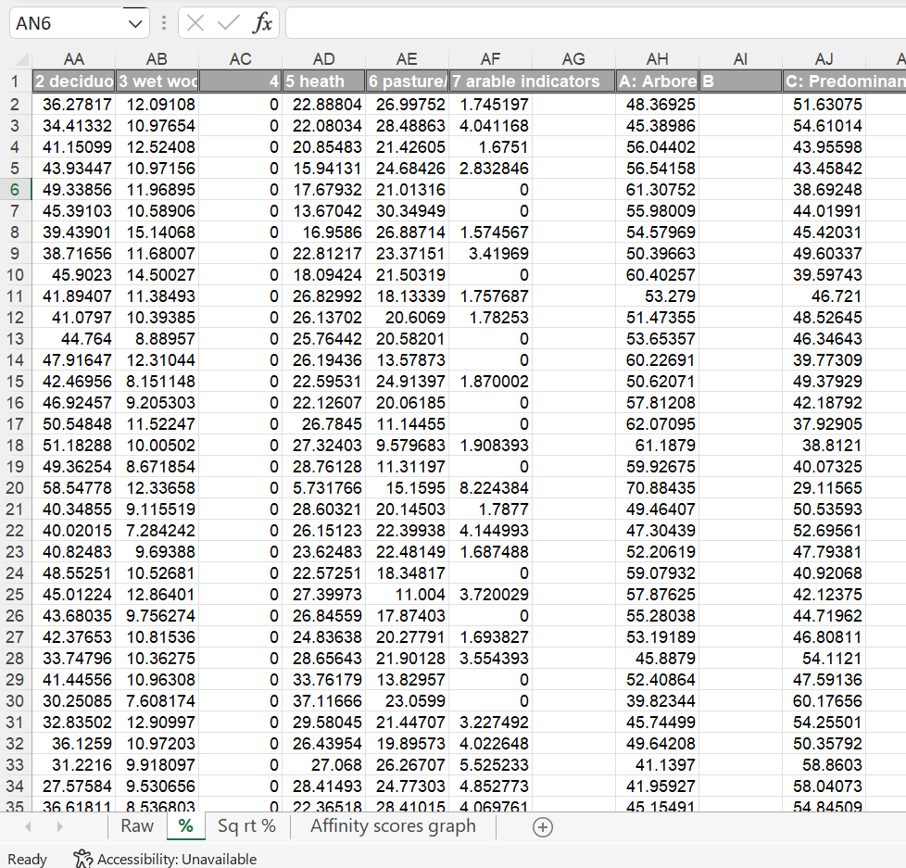
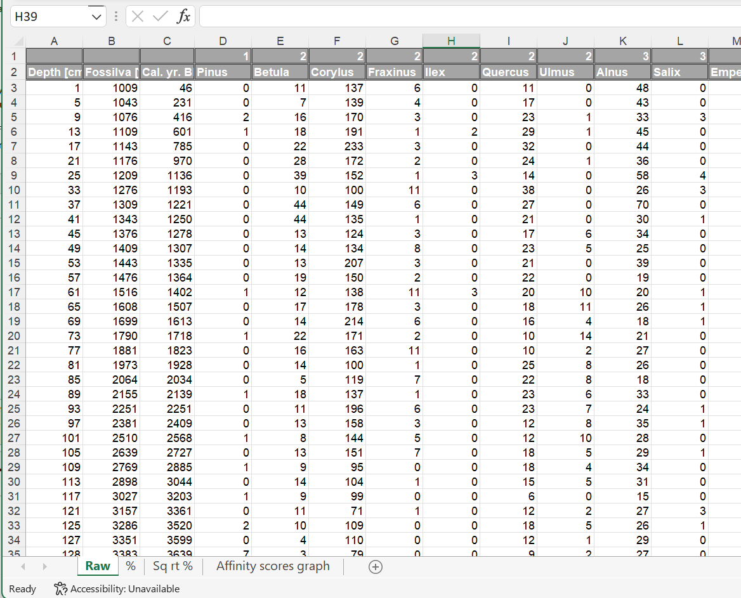
Do you need the tidyverse?
Do you have many separate files / sheets of the same data? (counts, percentages, subsets, aggregated)
Raw counts
Percent
Transformed
Aggregated
If yes, then you should aim to have only one file and do all processing in R.
More efficient (fewer files to keep track of)
Reduces errors (and easier to correct errors and update data – only 1 file to change)
Reproducible (record of what you did and why)

Slide 6
Example: Impact of the Neolithic Agricultural Transition
Jessie Woodbridge, Ralph Fyfe & colleagues
Woodbridge et al. (2014) & Fyfe et al. (2010)
Aim: Reconstruct anthropogenic land-cover change in Britain over the last 9000 years
Fyfe, et al. 2010. A pollen-based pseudobiomisation approach to anthropogenic land-cover change. The Holocene 20:1165-1171.
Woodbridge, et al. 2014. The impact of the Neolithic agricultural transition in Britain: a comparison of pollen-based land-cover and archaeological 14C date-inferpoll population change. Journal of Archaeological Science 51:216-224.
Thanks to Jessie Woodbridge and Ralph Fyfe for sharing their data!
Land-cover reconstructions for Britain
Figure 3 from Woodbridge et al. (2014)

Slide 7
Day 1 aims
Morning
Aims: To reproduce Woodbridge et al. Figure 3 using Tidyverse methods & explore changes in palynological richness.
Work through analysis of a single site using base R
Repeat using Tidyverse
Apply to all (41) sites & create synthesis figure
Modelling species richness with the Tidyverse
Afternoon
Demonstration of my new package riojaPlot for plotting stratigraphic diagrams
Work with your own data, ask questions, get help

Slide 8
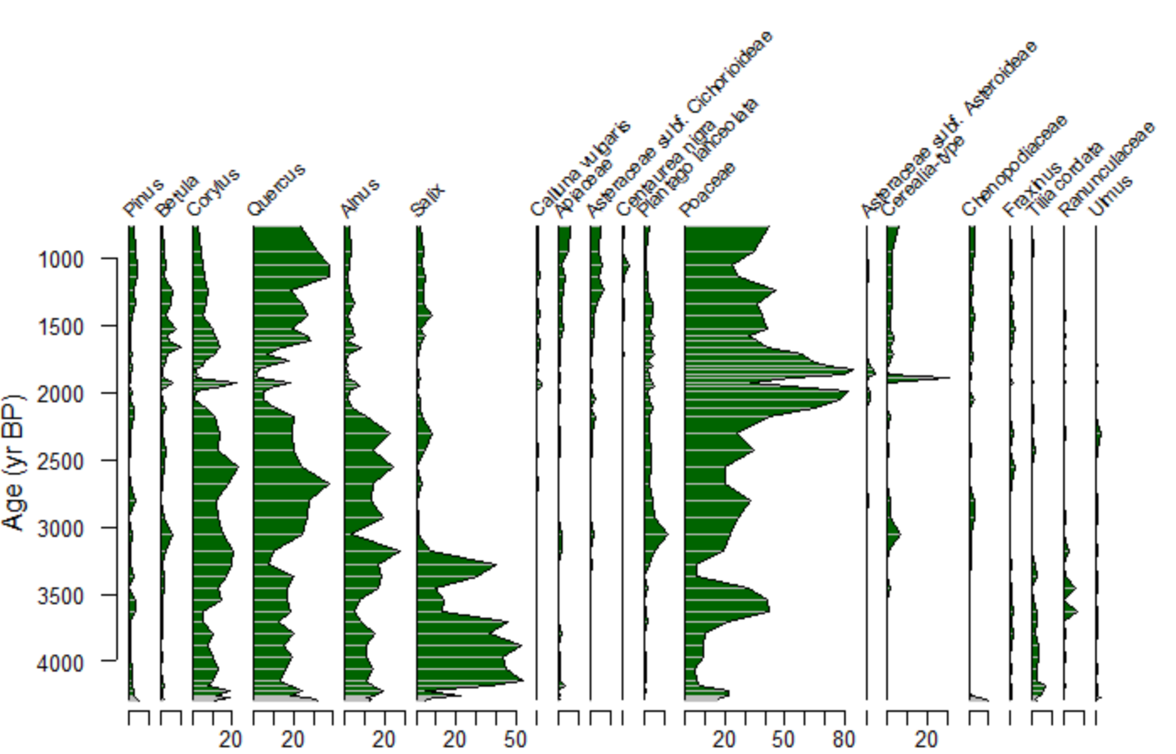
Example: Impact of the Neolithic Agricultural Transition
Extract dated pollen profiles from European pollen database (+ other sources), 41 sites in total.
Classify each pollen type to a land cover class (LCC)
For each site, transform species data to major vegetation types (land cover class: LCC) and calculate the dominant LCC for each sample.
Sum dominant LCCs for all sites in 200 year time slices, convert to % of each LCC & plot.
1
2
3
3
Fyfe et al. (2010)
4

Slide 9
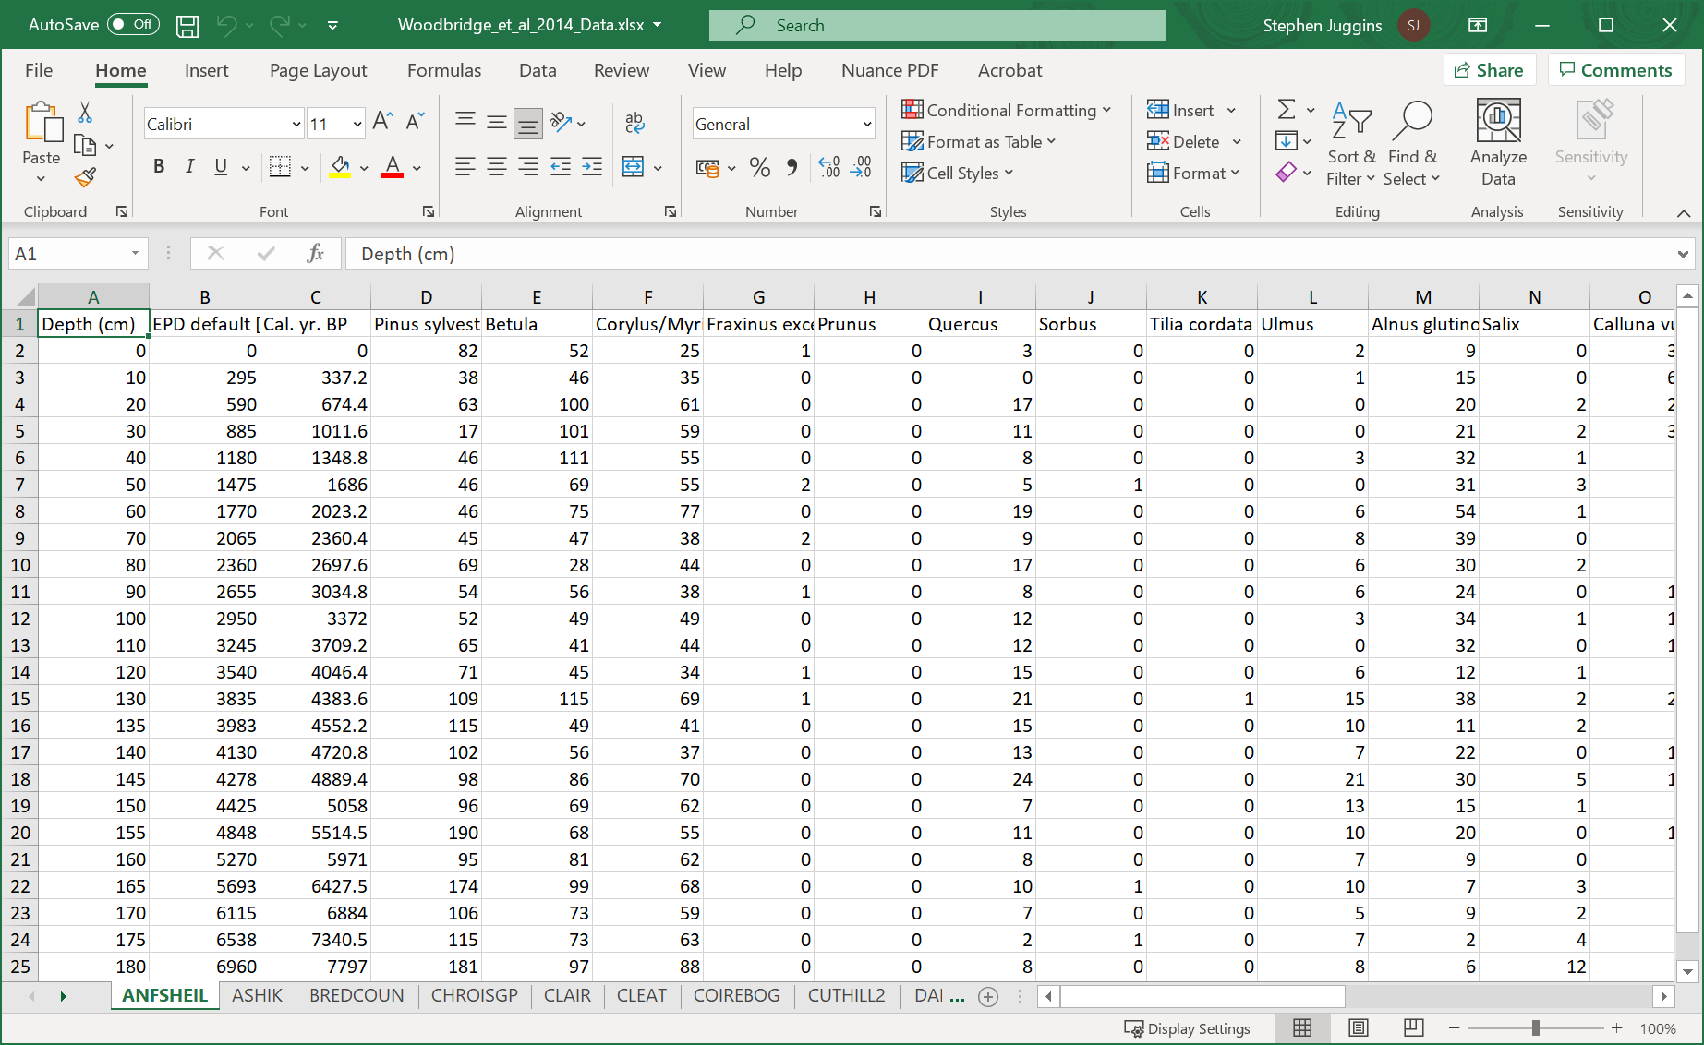
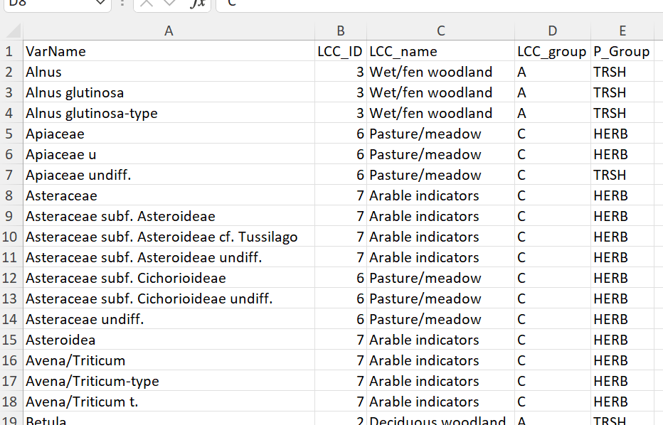
The data
Woodbridge_et_al_2014_Data.xlsx: Excel file with pollen counts for 42 sites, each site on a separate tab. Columns for pollen types, Depth and Cal. Age BP + alternative chronologies, sample IDs & and pollen sum.
LCC_Info.xlsx: Excel file with the following worksheets: LCC_lookup: Lookup table of taxon names and corresponding land cover classes.
Site_info: Information about each site, including region, grid references etc.

Slide 10
Land Cover Classification (LCC) method
Step1: Calculate LCC for each site
Import data
Clean data - remove unwanted columns
Rename columns
Convert counts to percentages
Allocate each pollen type to an LCC class and sum sqrt-percentages across each class
Normalise the sqrt-percent LCC data to 100%
Identify the dominant LCC class at each level
Step2: Aggregate multiple sites
Aggregate data from all sites and count the number of levels in each LCC class in 200 year time slices (N)
Convert N to percentage of each LCC class in each time slice
Plot the aggregated data

Slide 11
Part 1: Code Step 1 in Base R

Slide 12
Palaeodata wrangling with the tidyverse

Slide 13
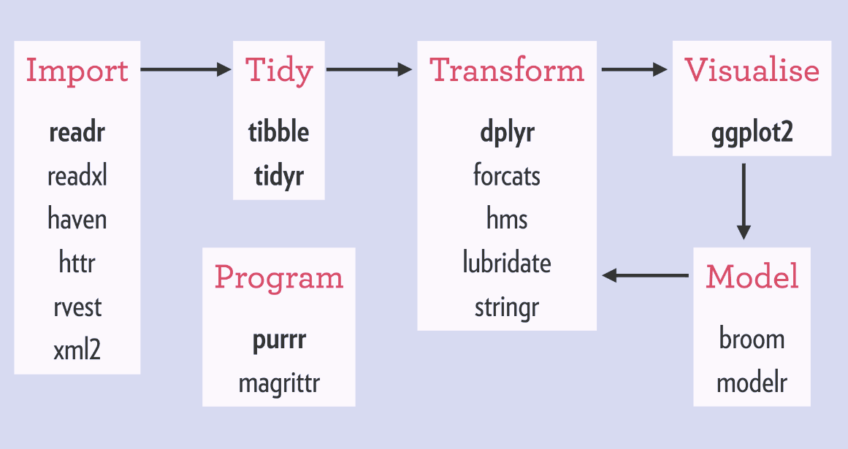
What is the Tidyverse?
Collection of R packages designed for data science that share common interface standards, grammar and data structures
You spend more time on concepts and less sorting out syntax
Promotes code readability
Both general purpose packages: tibble for data frames, tidyr for tidying, dplyr for transforming and ggplot for visualisation, and specialised packages for data import (readxl), dates & time (lubridate, hms), strings (stringr), factors (forcats) plus others.

Slide 14
Core features
Uses tibbles rather than data frames
refined print method strict about $ subsetting, doesn’t like rownames
easier to created nested data frames
Encourages use of the pipe %>%
Instead of summary(lm(y~x, data=df))
Use df %>% lm(y~x, data=.) %>% summary()
Promotes use of tidy data
Every column is a variable Every row is an observation Every cell is a single value

Slide 15
Tidy data
Not tidy ! (because the variable is pollen type and the attributes are taxon and count)
Tidy ! (Each column is a variable, pollen counts are described by key/value pairs)
Wide format
Long format
Convert from wide to long with
pivot_longer()
Convert from long to wide with
pivot_wider()
df %>% pivot_longer(
cols=-c(`Depth (cm)`, `Cal. yr. BP`), names_to="Taxon", values_to="Count")
df %>% pivot_wider(
id_cols=c(`Depth (cm)`, `Cal. yr. BP`), names_from=Taxon, values_from=Count)
In package tidyr

Slide 16
dplyr functions for data transformation
dplyr function
Base R equivalent
select: select columns (subset)
filter: subsetting rows based on condition (subset)
arrange: sorting (sort, order)
distinct: find unique values (unique)
slice: selecting rows based on position ([])
mutate: create new columns (transform)
group_by: defining groups of rows to process subsets
summarise: summarise data (optionally by group) (aggregate)
*_join: merging data sets (merge)
bind_rows, bind_cols: combine multiple dfs by row or column (rbind, cbind)

Slide 17
Creating new variables using mutate
df %>%
mutate(SQRT_Count=sqrt(Count))
A tibble: 9 x 5
`Depth (cm)` `Cal. yr. BP` Taxon Count SQRT_Count
<dbl> <dbl> <chr> <dbl> <dbl>
1 132 1514 Pinus sylvestris 3 1.73
2 132 1514 Taxus baccata 1 1
3 132 1514 Betula 40 6.32
4 132 1514 Betula/Corylus/Myrica 2 1.41
5 164 1618. Pinus sylvestris 3 1.73
6 164 1618. Taxus baccata 3 1.73
7 164 1618. Betula 33 5.74
8 164 1618. Betula/Corylus/Myrica 1 1
9 196 1723 Pinus sylvestris 3 1.73

Slide 18
Summarising by group
Split -> Apply -> Combine
df %>% summarise(Total=sum(Count))
Total
<dbl>
1 89
df %>%
group_by(`Depth (cm)`) %>%
summarise(Total=sum(Count))
`Depth (cm)` Total
<dbl> <dbl>
1 132 46
2 164 40
3 196 3

Slide 19
Compute new variables by group
df %>%
group_by(`Depth (cm)`) %>%
mutate(Percent=Count/sum(Count)*100)
`Depth (cm)` `Cal. yr. BP` Taxon Count Percent
<dbl> <dbl> <chr> <dbl> <dbl>
1 132 1514 Pinus sylvestris 3 6.52
2 132 1514 Taxus baccata 1 2.17
3 132 1514 Betula 40 87.0
4 132 1514 Betula/Corylus/Myrica 2 4.35
5 164 1618. Pinus sylvestris 3 7.5
6 164 1618. Taxus baccata 3 7.5
7 164 1618. Betula 33 82.5
8 164 1618. Betula/Corylus/Myrica 1 2.5
9 196 1723 Pinus sylvestris 3 100

Slide 20
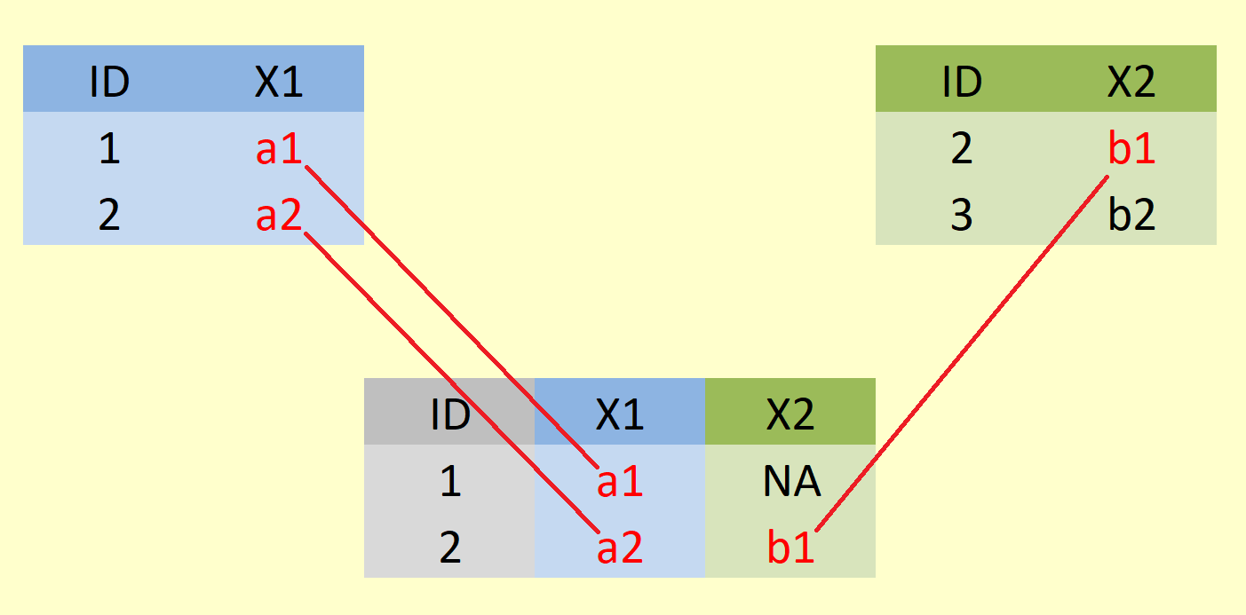
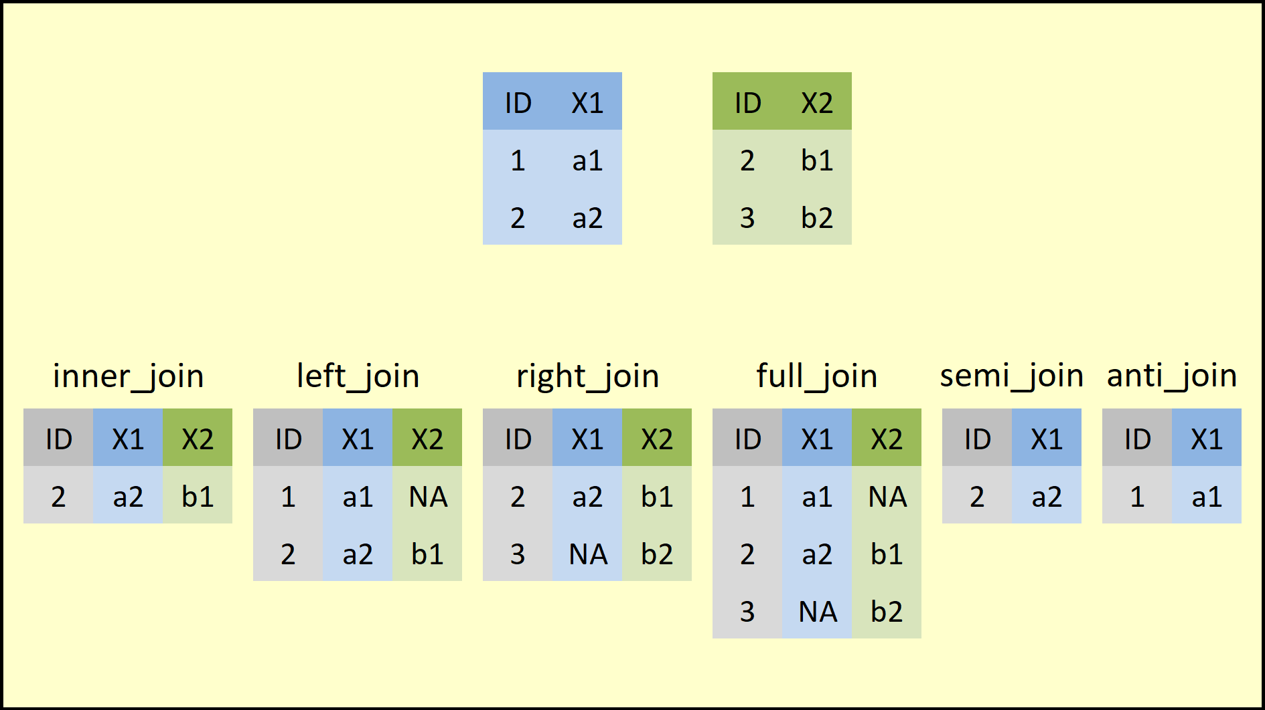
Merging tables
Join or merge tables using column(s) common to both tables
Left join – all rows from left df, matching rows from right
Other join types
Df1 %>% left_join(df2, by=‘ID’)
Mutating joins: combine variables from the 2 sources
Filtering joins: use right hand df to filter rows in lh df
Figures from https://statisticsglobe.com/r-dplyr-join-inner-left-right-full-semi-anti

Slide 21
Working across rows using across()
# Base R replace in situ
df[is.na(df)] <- 0
# Base R create new df
replace(df, is.na(df), 0)
# Tidyverse, replace NAs in a single column
df %>% mutate(Betula = replace_na(Betula, 0)))
Use across() to select, rename, or apply a transformation to multiple columns
across(.cols = everything(), .fns = NULL, ..., .names = NULL)
.cols = columns to transform
.fns = function to apply to each column
.names = how the new columns will be names (default is to use original names)
# Tidyverse, replace NAs except in cols 1 & 2
df %>% mutate(across(-(1:2), ~replace_na(.x, 0)))
placeholder for passed column

Slide 22
Part 2: Code it using the Tidyverse

Slide 23
Code comparison: Part 1
Base R
Tidyverse
polldata <- read_excel("Woodbridge_et_al_2014_Data.xlsx", sheet="REDMERE")
lcc_lookup <- read_excel("LCC_info.xlsx", sheet="LCC_Lookup")
lcc_lookup
non_pollen <- c("Sample","Radiocarbon years B.P.", "EPD default [yrs.BP.]", "EPD [yrs.BP.]", "Fossilva [yrs.BP.]", "Sum")
del <- colnames(polldata) %in% non_pollen
polldata <- polldata[, !del]
depth_age <- subset(polldata, select=c(`Depth (cm)`, `Cal. yr. BP`))
poll_count <- subset(polldata, select=-c(`Depth (cm)`, `Cal. yr. BP`))
colnames(depth_age) <- c("Depth", "Age_BP")
poll_pc <- poll_count / rowSums(poll_count) * 100
poll_sqrt <- sqrt(poll_pc)
sel <- match(colnames(poll_sqrt), lcc_lookup$VarName)
taxa_lcc <- lcc_lookup[sel, ]
poll_lcc <- t (rowsum(t(poll_sqrt), group=taxa_lcc$LCC_name))
poll_lcc <- data.frame(poll_lcc, check.names=FALSE)
poll_norm <- poll_lcc / rowSums(poll_lcc) * 100
dominant_class <- apply(poll_norm, 1, which.max)
poll_norm$lcc_class <- factor(colnames(poll_norm)[dominant_class])
sum_arboreal <- rowSums(poll_norm[, c("Coniferous woodland",
"Deciduous woodland",
"Wet/fen woodland")]) # arboreal sum_open <- rowSums(poll_norm[, c("Heath",
"Pasture/meadow",
"Arable indicators")]) # open poll_norm$Affinity <- sum_arboreal - sum_open
plot(depth_age$Age_BP, poll_norm$Affinity, type="l",
xlab="Age (years BP)",
ylab="Affinity")
points(depth_age$Age_BP, poll_norm$Affinity, pch=19, cex=1, col=as.integer(poll_norm$lcc_class))
legend("topleft", pch=19, col=1:7, legend=levels(poll_norm$lcc_class))
polltidy <- read_excel("Woodbridge_et_al_2014_Data.xlsx", sheet="REDMERE")
lcc_lookup <- read_excel("LCC_info.xlsx", sheet="LCC_Lookup")
non_pollen <- c("Sample","Radiocarbon years B.P.", "EPD default [yrs.BP.]", "EPD [yrs.BP.]", "Fossilva [yrs.BP.]", "Sum")
polltidy_long <- polldata %>%
rename("Depth"=`Depth (cm)`, "Age_BP"=`Cal. yr. BP`) %>%
pivot_longer(cols=-c("Depth", "Age_BP"),
names_to="VarName", values_to="Count") %>%
filter(!(VarName %in% non_pollen))
polltidy_sqrt <- polldata_long %>%
group_by(Depth) %>%
mutate(Percent = Count / sum(Count) * 100,
SQRT_PC = sqrt(Percent)) %>%
ungroup()
polltidy_norm <- polltidy_sqrt %>%
left_join(lcc_lookup, by="VarName") %>%
group_by(Depth, Age_BP, LCC_name, LCC_group) %>%
summarise(SQRT_PC=sum(SQRT_PC), .groups="drop") %>%
group_by(Depth, Age_BP) %>%
mutate(Norm_SQRT_PC=SQRT_PC/sum(SQRT_PC)*100) %>%
ungroup() %>%
select(-SQRT_PC)
polltidy_lcc <- polltidy_norm %>%
group_by(Depth, Age_BP) %>%
mutate(A=sum(Norm_SQRT_PC[LCC_group=="A"]),
C=sum(Norm_SQRT_PC[LCC_group=="C"]),
Affinity=A-C) %>%
select(-c(A, C)) %>%
slice_max(Norm_SQRT_PC, n=1, with_ties=FALSE) %>%
select(-c(Norm_SQRT_PC)) %>%
ungroup()
ggplot(polltidy_lcc, aes(x=Age_BP, y=Affinity, col=LCC_name)) +
geom_line(col="grey") +
geom_point(size=2) +
scale_x_continuous(breaks=seq(0, 10000, by=500)) +
labs(x="Years BP") +
scale_colour_discrete(name="LCC") +
theme(legend.position="top") +
guides(col=guide_legend(nrow=2))

Slide 24
Working with multiple datasets – base R
How to apply our LCC code for 1 site to many?
Use a for loop!
for (val in sequence) {
statement
}
sequence is a vector and val takes on each of its values during the loop. In each iteration statement is evaluated.
x <- 1:5
for (i in x) {
print(i)
}
[1] 1
[1] 2
[1] 3
[1] 4
[1] 5

Slide 25
Rewriting code as a function
To apply our LCC function to multiple sites we can use a loop and collate results at each iteration.
We could include all the LCC code within the loop but this is not good – makes the code more complex, and we should aim to reuse code, not repeat it.
Encapsulate the code in a function, and call the function from within the loop.
Defining a function:
my_fun <- function(arg1, arg2, ...) {
statements
return(object)
}
Example:
my_fun <- function(a, b) {
c <- a + b
return(c)
}
my_fun(2, 3)
[1] 5

Slide 26
Part 3: Code to aggregate multiple sites Base R

Slide 27
Working with multiple datasets – Tidyverse
Two approaches with Tidy functions that avoid loops and produce more readable, elegant code:
Combined, stacked data
Grouped by Site and Age range
Calculate LCCs for each Site / Age range
Convert each df to long format, and stack, and perform summaries / transformations by grouping of Site and Age/Depth
Convert to nested data frame that stores data of each site within the cell of a larger organising table. Apply a function to each nested table and collate results.
We use second approach to clean data and convert to long format and stack the data, then use first approach to calculate LCC from the stacked dataset.
Combined, nested data
Apply LCC function to each df
Figures from tidyverse cheat sheets

Slide 28
Working with nested data using purrr
Useful functions:
tidyr::nest(df, cols): creates data frame with cols nested within grouped defined by the non-nesting columns.
tidyr:: unnest(df, cols): unnests a nested column col of a nested data frame.
purrr::map applies a function to each element of a list or vector (ie. each data frame of a nested data frame)

Slide 29
Working with nested data frames
Original data frame
Nested data frame
iris
A tibble: 150 x 5
Sepal.Length Sepal.Width Petal.Length Petal.Width Species
<dbl> <dbl> <dbl> <dbl> <fct>
1 5.1 3.5 1.4 0.2 setosa
2 4.9 3 1.4 0.2 setosa
3 4.7 3.2 1.3 0.2 setosa
4 4.6 3.1 1.5 0.2 setosa
5 5 3.6 1.4 0.2 setosa
6 5.4 3.9 1.7 0.4 setosa
7 4.6 3.4 1.4 0.3 setosa
8 5 3.4 1.5 0.2 setosa
9 4.4 2.9 1.4 0.2 setosa
10 4.9 3.1 1.5 0.1 setosa
n_iris <- iris %>% nest(data = -Species)
n_iris
A tibble: 3 x 2
Species data
<fct> <list>
1 setosa <tibble [50 x 4]>
2 versicolor <tibble [50 x 4]>
3 virginica <tibble [50 x 4]>
List-column named “data”
Use map to apply function summary to each nested table
n_iris$data %>% map(summary)
[[1]]
Sepal.Length Sepal.Width Petal.Length Petal.Width
Min. :4.300 Min. :2.300 Min. :1.000 Min. :0.100
1st Qu.:4.800 1st Qu.:3.200 1st Qu.:1.400 1st Qu.:0.200
Median :5.000 Median :3.400 Median :1.500 Median :0.200
Mean :5.006 Mean :3.428 Mean :1.462 Mean :0.246
3rd Qu.:5.200 3rd Qu.:3.675 3rd Qu.:1.575 3rd Qu.:0.300
Max. :5.800 Max. :4.400 Max. :1.900 Max. :0.600
[[2]]
Sepal.Length Sepal.Width Petal.Length Petal.Width
Min. :4.900 Min. :2.000 Min. :3.00 Min. :1.000

Slide 30
Working with nested data frames
Apply base R function summary to each
nested table and add results to original nested df
n_iris %>% mutate(summary = map(data, summary))
A tibble: 3 x 3
Species data summary
<fct> <list> <list>
1 setosa <tibble [50 x 4]> <table [6 x 4]>
2 versicolor <tibble [50 x 4]> <table [6 x 4]>
3 virginica <tibble [50 x 4]> <table [6 x 4]>
Use formula version to supply arguments to function (in this case lm)
n_iris %>% mutate(model = map(data, ~lm(Sepal.Width~Sepal.Length, data=.x)))
A tibble: 3 x 3
Species data model
<fct> <list> <list>
1 setosa <tibble [50 x 4]> <lm>
2 versicolor <tibble [50 x 4]> <lm>
3 virginica <tibble [50 x 4]> <lm>
Use “.x” to pass the df in the first argument to map to the mapped function

Slide 31
Part 4: Code to aggregate multiple sites using Tidyverse

Slide 32
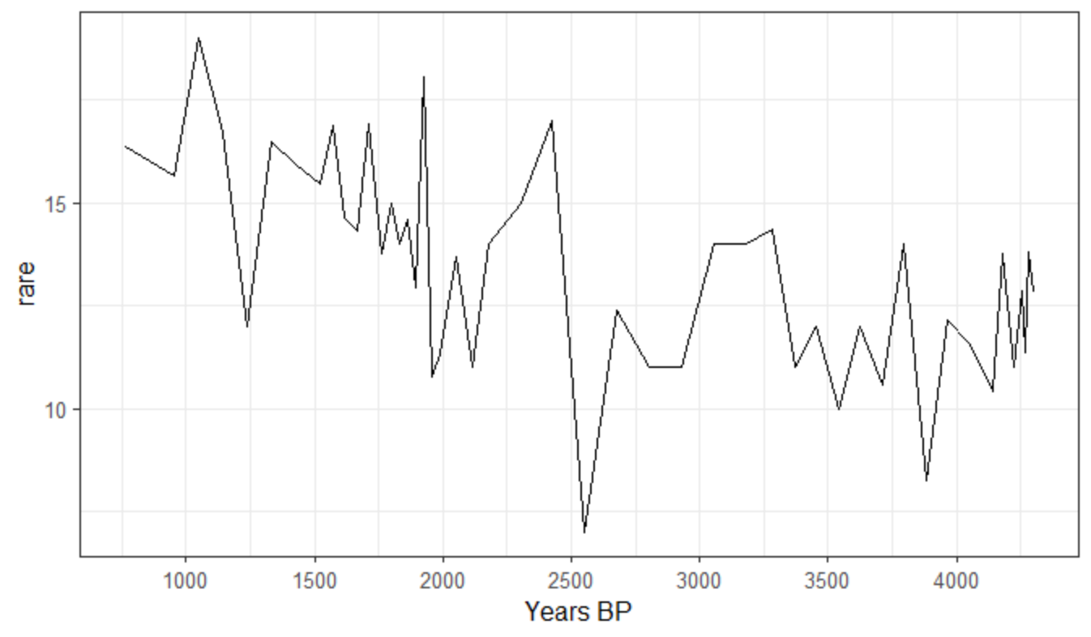
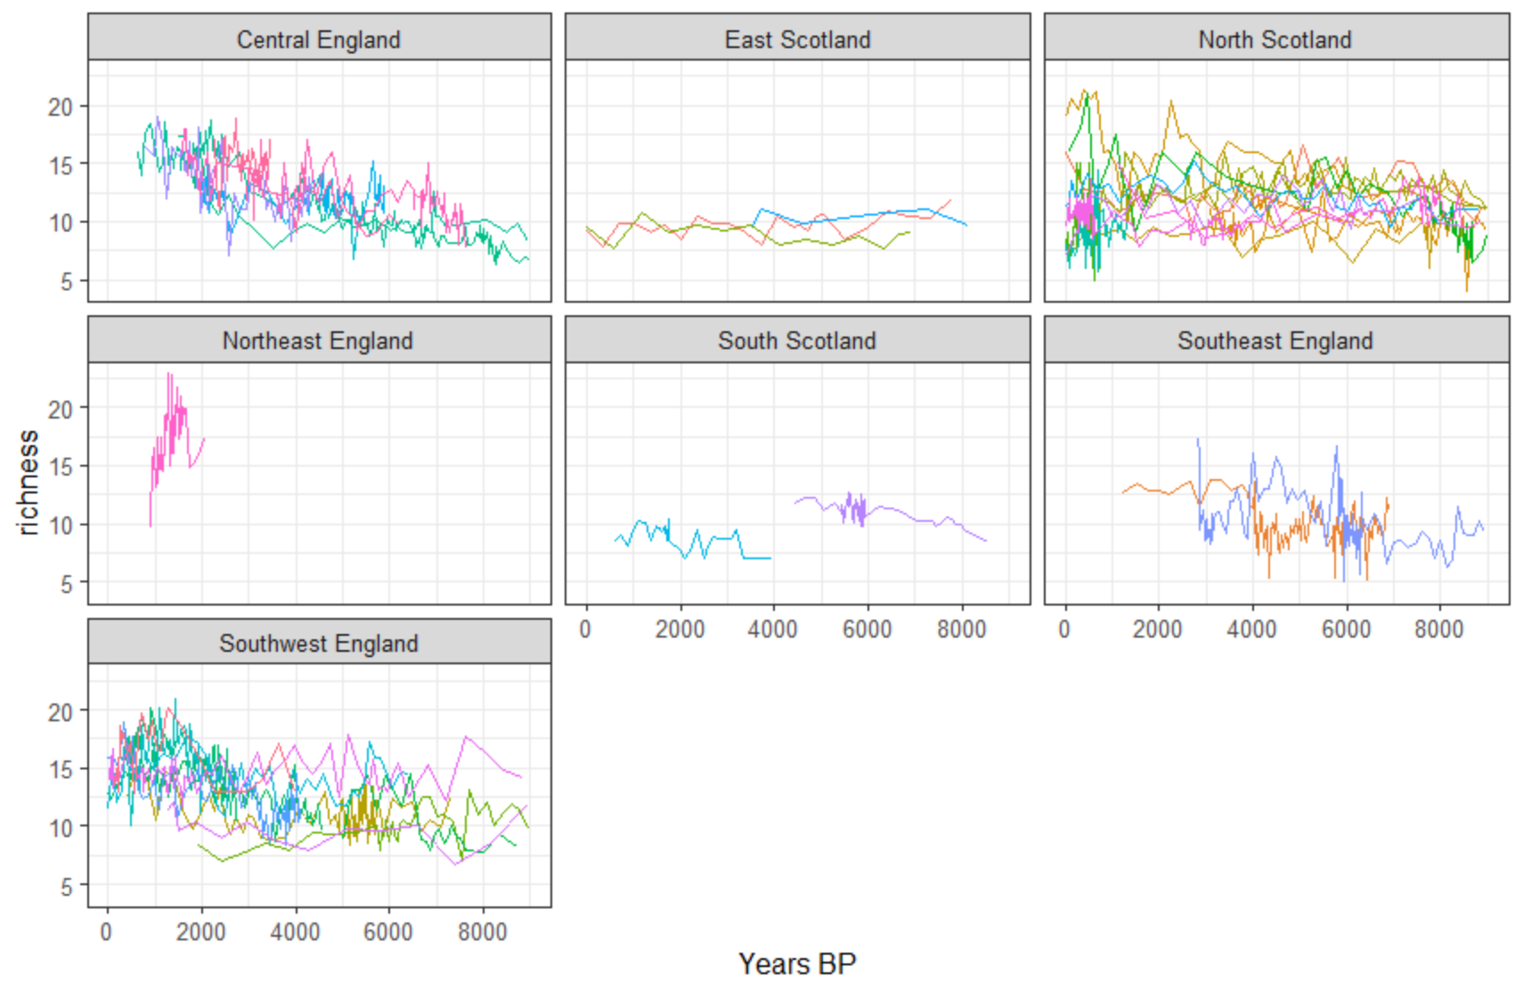
Part 5: Modelling with the Tidyverse
Calculate palynological richness using rarefaction
Apply model to all sites
Very simple questions: Which sites show significant trend in richness?
How does richness vary with landscape “openness”

Slide 33
broom for tidying model output
The problem
Not tidy!
No common format
Tidy(ish) data
Model
The broom solution
Model
Convert to tidy with consistent output format
for multiple model types (currently >130 included, easy to add your own).
tidy: tibble that summarises model findings (e.g. coefficients, p-values)
glance: concise one-row summary (e.g. r-squared, degf)
augment: columns original data was modelled on (e.g. predictions, residuals)

Slide 35
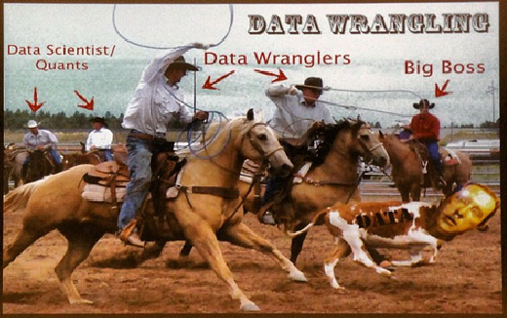
Afternoon (13:30-15:30): Bring your own data

